Slide 1
HVAC / Fixture Financing Program

Slide 2
About Arvest
39 branch locations throughout Tulsa and surrounding communities.
Vendor loan program serviced through central processing center at 51st and Garnett
Offer financing options for both consumer and commercial requests

Slide 3
Why offer financing for customers?
Allows customers to make purchases that they otherwise would not have the ability to pay for with cash savings
Ability to make payments over time that fits within the customer’s budget
Potential for upsell to higher ticket items
Increased sales

Slide 4
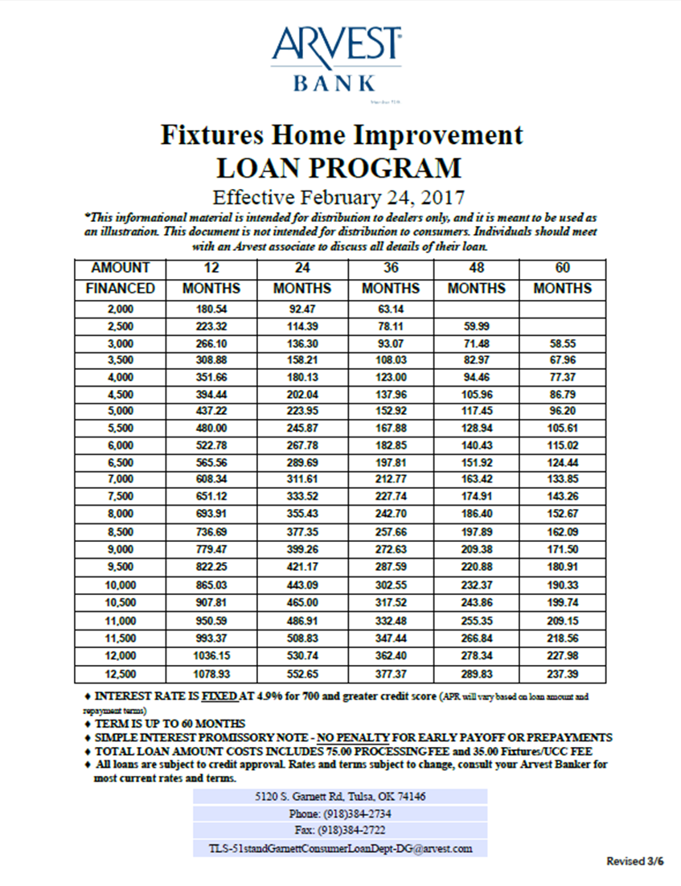
Rates/Terms
Amounts up to $25,000
Credit score 700 and above
4.9% for 60 months
5.75% for 84 months
Credit score under 700
5.9% for 60 months
7.9% for 84 months

Slide 5
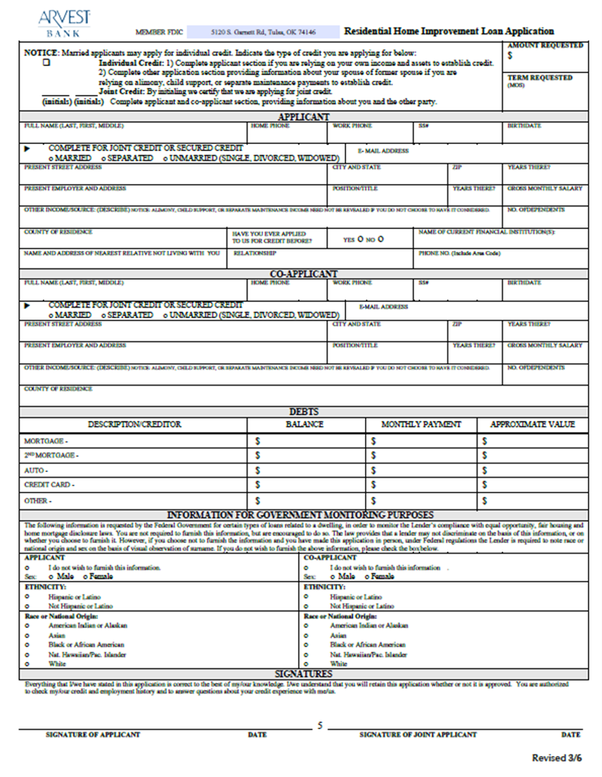
How to submit applications
Applications and estimates can be submitted by phone, email, or fax.
Lender will notify the contractor after loan decision has been made.

Slide 6
ProceSS
Contractor will provide serial numbers and final invoice amount
Arvest will contact customers to set up closing
Customer’s can sign loan documents at closest Arvest branch location.
Loans can be funded by cashier’s check or can be directly deposited into an Arvest account.

Slide 7
ProceSS
Funds are disbursed when the project has been completed. (Completion Certificate provided)

Slide 8
Commercial HVAC Financing
5.99% High Efficiency fixed rate
6.99% Standard Efficiency fixed rate
Terms up to 60 months
No early payoff penalty
Simple application process
Custom financing & terms available for large or complex systems

Slide 9
Questions?

