Slide 1
®
®

Slide 2
OG&E Energy Efficiency Program Introductions
Oklahoma
Notes:
Introduce ourselves and CLEAResult
Forrest McGee – OG&E CEEP Program Manager
Gale Lewis – OG&E HEEP Program Manager
Jeremy Sims – Portfolio Manager
Program Managers are Greg, Josh, Hayley, Robert, Jed, and Jerad
All contact information located in each section of the presentation

Slide 3
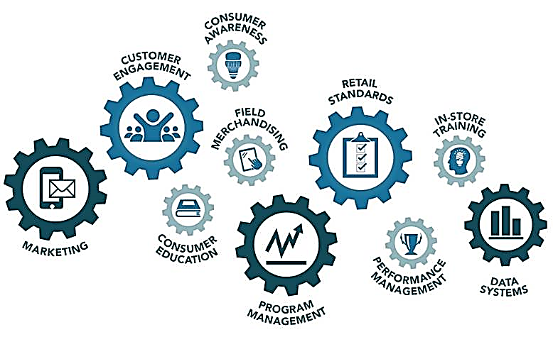
Comprehensive Program Approach
®
Notes:
Specific differentiator this year in how we run programs is that we will be taking a targeted marketing approach
Residential customers engaged through OG&E website
Commercial customers engaged through targeted efforts in each vertical
Education is integral, and opportunities to educate will reach beyond our traditional schools offerings to large commercial and even residential consumers
Energy Advisors
Higher level of program management this year
CLEAResult hired because of our performance with Schools and Small Businesses
Last year – few employees, this year – 47 dedicated employees in downtown OKC
Integrated solutions with databases and unified customer experience from initial contact through portal to calls with energy advisors
Unified approach to operation of programs
Processes are the same for customers
Trade Allies are far more varying, so engagement with programs has diversified paths
In the end, it’s all about evaluation
Third party evaluator is interested in why customers perform projects, and protecting interests of OCC
Moved from demand based incentive compensation to consumption based
Overall approach should/will create higher realization rates for OG&E

Slide 4
Residential
Programs

Slide 5
Residential Solutions
Offering
OG&E on-line energy profile
Customers provide basic information about their home
On-site assessment scheduled with Energy Advisor
Assessment and direct install of LEDs and Advanced Power Strips
Additional project recommendations
Support Systems
Energy Advisors – Contact Center: support customers with next steps; education and contractors
®

Slide 6
A/C Tune-Up Programs
Opportunity
Poorly installed/maintained HVAC systems can consume up to 45% of residential electric energy
Higher SEER efficiency units reduce demand and monthly utility bills
Offering
Opportunity offered during assessment
Qualified contractor assigned by program
Advanced tune-up with iManifold tool
Enable visibility and support
Provide wireless access and interface
Support QA/QC and customer satisfaction as top priorities
®

Slide 7
Positive Energy Home – New Construction
Program Goal
Provide incentives to Home Builders to exceed standard building codes to support reduced energy costs long-term for home owners
Offering
Window upgrades
Whole Home Air Sealing
High Efficiency HVAC systems
Improved Insulation
Target 1,200 new construction homes a year
®

Slide 8
Consumer Products Offering
Merchandising and product displays
Conducting price audits and verification
In-store consumer outreach and engagement
Retailer training
Building and maintaining retailer relationships
®

Slide 9
Trade Ally Partners
®
Notes:
Funded by OG&E
Partnered with eight retailers and six manufacturers
Markdowns on ENERGY STAR qualified LEDs
Incentives reflected at point-of-sale
No mail in form needed
Invoiced sales are reported monthly and audited
Used to calculate kWh savings

Slide 10
Residential Program Management
Residential Solutions
Hayley.Burns@CLEAResult.com
Advanced A/C Tune-Ups and Replacements
Robert.Robertson@CLEAResult.com
Positive Energy Homes – New Construction
Jerad.Wiskus@CLEAResult.com
Consumer Products
Jed.Hannemann@CLEAResult.com
®

Slide 11
Commercial
Programs

Slide 12
Small Commercial Program Offerings
Midstream – Retail (distributors)
Point of Sale lighting rebate program
Small Business
Trade-Ally sales driven
Prescribed for small business projects – Lighting & Refrigeration
Schools and Government
Provides high incentives and educational components
Facility benchmarking and energy master planning sessions
Projects are custom, but typically Lighting
®

Slide 13
Distributors
®
Notes:
Have scheduled or are scheduling about a dozen individual training sessions
Just a sample of our participating distributors

Slide 14
Large Commercial Program Offering
Offering
Custom project approach
Integrated solutions for customer projects
Solutions for any/all vertical markets
New construction recommendations – engaging design team
Engineering services – ASHRAE Level I and II audits
CEI (Continuous Energy Improvement) – 2 year program for select large customers
®

Slide 15
Custom Project Savings
Many approaches and/or options:
Lighting
Heating and Cooling
Compressed Air
Controls or Occupancy Sensors
Retro-Commissioning / Tune-ups
Behavioral
Modeling
®
Notes:
Case Study details

Slide 16
C&I Program Management
Small Commercial – Midstream, Direct Install and Schools & Government Programs
Josh.Wurdeman@CLEAResult.com
Continuous Energy Improvement (CEI) Program
Kyle.Robison@CLEAResult.com
Large Commercial – Projects & Audits
GHolm@CLEAResult.com
®

